Slide 1
DAYANANADA SAGAR UNIVERSITY
TOPIC- MIMO ANTENNA

Slide 2

What is MIMO (Multiple-Input Multiple-Output)?
MIMO stands for Multiple-Input Multiple-Output. It is a wireless communication technology that utilizes multiple antennas at both the transmitting and receiving ends to improve the performance and capacity of wireless networks.
In traditional wireless systems, there is typically only one antenna at each end of the communication link. However, with MIMO technology, multiple antennas are used to transmit and receive data simultaneously. This allows for increased data throughput, improved signal quality, and enhanced coverage.

Slide 3
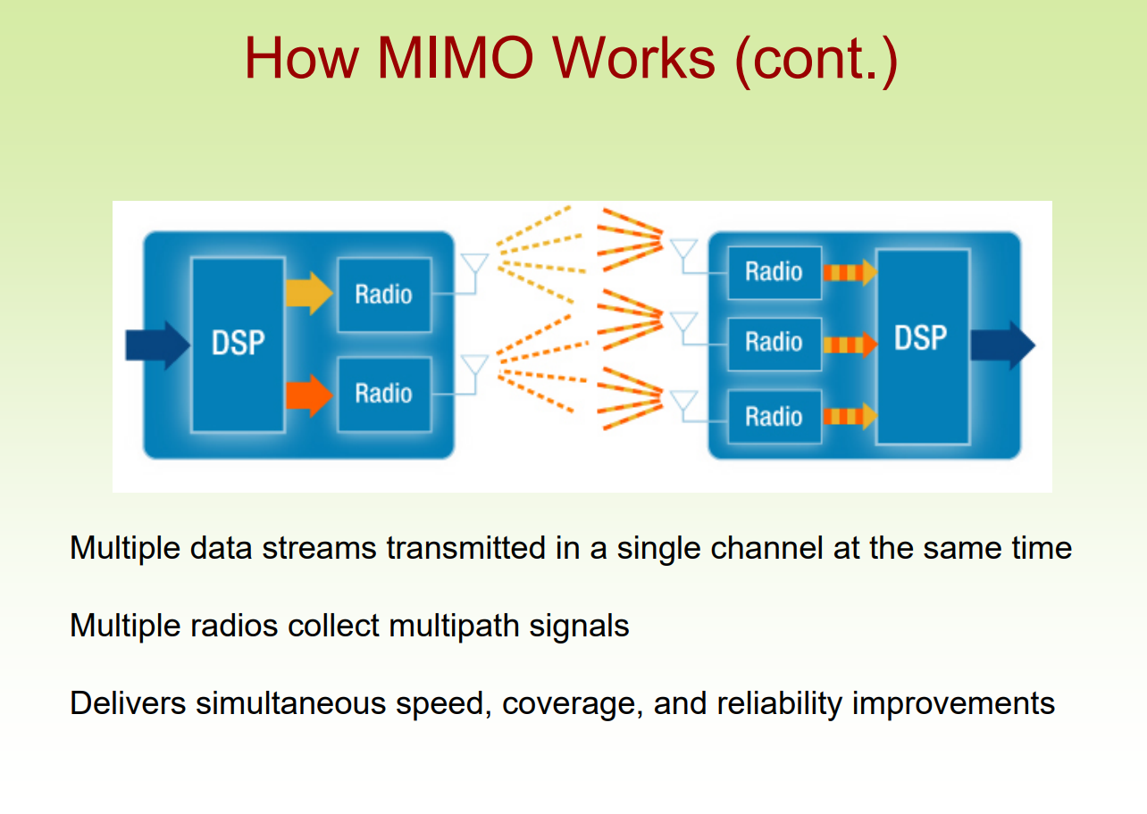
How Does MIMO Work?
In a MIMO system, multiple independent data streams are transmitted simultaneously over the same frequency channel using multiple antennas. At the receiver end, the signals from the multiple antennas are combined and processed to extract the original data streams. This process is known as spatial multiplexing.
MIMO takes advantage of multipath propagation, where the transmitted signals bounce off various obstacles and arrive at the receiver from different paths. Instead of treating these multipath components as interference, MIMO exploits them to enhance the overall signal quality and data throughput.

Slide 4
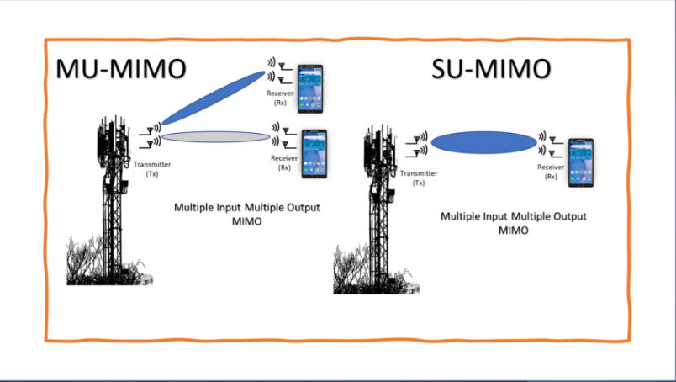
Types of MIMO Systems-
Single-User MIMO (SU-MIMO): In SU-MIMO, the multiple antennas are used to create a dedicated high-throughput link between a single transmitter and a single receiver.
Multi-User MIMO (MU-MIMO): MU-MIMO allows a single base station or access point to communicate with multiple users simultaneously, improving overall network capacity and efficiency.

Slide 5
Benefits of MIMO Technology-
Increased Data Throughput: By transmitting multiple data streams simultaneously, MIMO can significantly increase the overall data throughput and spectral efficiency of a wireless system.
Improved Signal Quality: MIMO leverages multipath propagation to enhance signal quality, reducing the effects of fading and interference.
Extended Range: The spatial diversity provided by MIMO helps to extend the range of wireless communications by improving the signal-to-noise ratio (SNR) at the receiver.
Enhanced Reliability: The redundancy introduced by multiple signal paths in MIMO systems improves the overall reliability and robustness of wireless connections.
Increased Capacity: MU-MIMO enables efficient spectrum utilization, allowing multiple users to share the same frequency channel, thereby increasing the overall network capacity.

Slide 6
Drawbacks-
The resource requirements and hardware complexity is higher compare to single antenna based system. Each antenna requires individual RF units for radio signal processing. Moreover advanced DSP chip is needed to run advanced mathematical signal processing algorithms.
The hardware resources increase power requirements. Battery gets drain faster due to processing of complex and computationally intensive. Signal processing algorithms. This reduces battery lifetime of MIMO based devices.
MIMO based systems cost higher compare to single antenna based system due to increased hardware and advanced software requirements.

Slide 7
MIMO in Modern Wireless Standards-
MIMO technology has been widely adopted in various wireless communication standards such as Wi-Fi (802.11n/ac/ax), 4G LTE Advanced, and 5G NR (New Radio). MIMO has become an integral part of modern wireless standards, including:
Wi-Fi: MIMO is widely used in Wi-Fi standards, such as 802.11n, 802.11ac, and 802.11ax (Wi-Fi 6), to achieve higher data rates and improved coverage.
LTE and LTE-Advanced: MIMO is a key enabler for higher data rates and increased spectral efficiency in LTE and LTE-Advanced cellular networks.
5G NR: 5G New Radio (NR) heavily relies on advanced MIMO techniques, including Massive MIMO and beamforming, to deliver ultra-high data rates, low latency, and improved network capacity.
By leveraging multiple antennas and spatial multiplexing, MIMO technology has revolutionized wireless communications, enabling higher data throughputs, improved signal quality, and increased network capacity, making it an indispensable component of modern wireless systems.

Slide 8
Applications-
MIMO is used in mobile radio telephone standards such as 3GPP and 3GPP2. In 3GPP, High-Speed Packet Access plus (HSPA+) and Long Term Evolution (LTE) standards take MIMO into account. Moreover, to fully support cellular environments, MIMO research consortia including IST-MASCOT propose to develop advanced MIMO techniques, e.g., multi-user MIMO (MU-MIMO).
MIMO wireless communications architectures and processing techniques can be applied to sensing problems. This is studied in a sub-discipline called MIMO radar.
MIMO technology can be used in non-wireless communications systems. One example is the home networking standard ITU-T G.9963, which defines a powerline communications system that uses MIMO techniques to transmit multiple signals over multiple AC wires (phase, neutral and ground).

Slide 9


